Slide 1
Governing Differential Equations
CE 544 – BRIGHAM YOUNG UNIVERSITY

Slide 2
Background
All of the flow conditions we have seen so far have been simple, 1-D problems where we could use Darcy’s Law directly. In most applications, however, the geometry and soil properties are more complex, and a more complete governing equation is needed.
The following derivation is a general form of the 3D case.

Slide 3

Assumptions
Soil is saturated
We could derive the equations to describe unsaturated flow, but we will stick to saturated flow in this class.
Darcy's law is valid
Mass is conserved
i.e., what goes in must come out or be stored based on conservation of mass.
$$inflow−outflow=\frac{Δstorage}{Δt}+sources,sinks$$

Slide 4
Steady State Saturated Flow
For this class, we will only consider the case where we have steady state conditions (system is in equilibrium - no change with time) and no sources/sinks. Thus, the two terms on right will be set to zero.
inflow - outflow = 0

Slide 5
Steady State Saturated Flow
inflow - outflow = 0
mass flow rate = ρ v

Slide 6
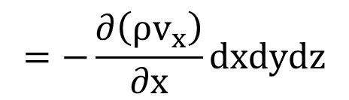
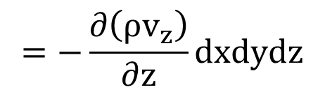
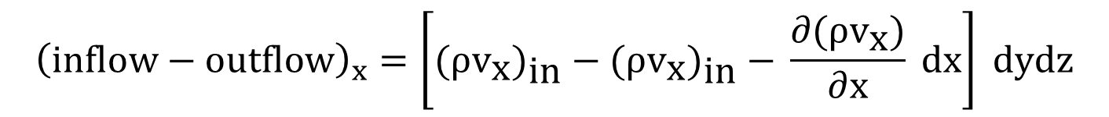
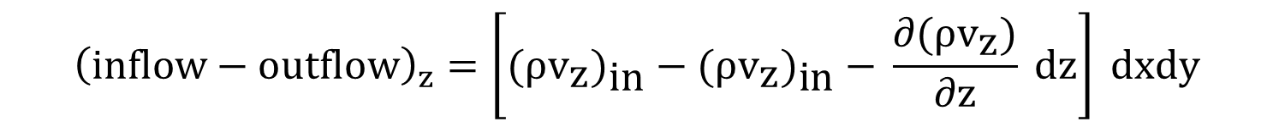
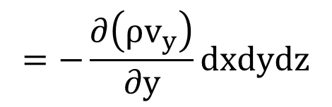
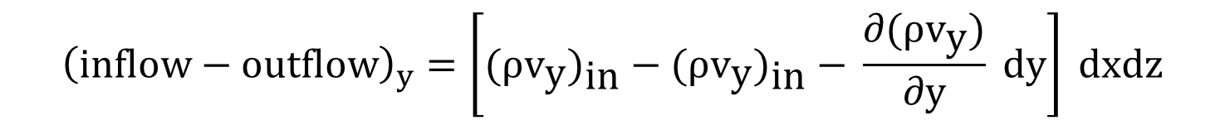
$${\left(inflow−outflow\right)}_{x}=\left[{\text{(}ρ{\text{v}}_{\text{x}}\text{)}}_{\text{in}}\text{ − (}ρ{\text{v}}_{\text{x}}{\text{)}}_{\text{in}}\text{ − }\frac{∂\text{(}ρ{\text{v}}_{\text{x}}\text{)}}{∂\text{x}} \text{dx}\right] \text{dydz}$$
$$=−\frac{∂\left(ρv_{x}\right)}{∂x}dxdydz$$
$${\left(inflow−outflow\right)}_{y}=\left[{\text{(}ρ{\text{v}}_{\text{y}}\text{)}}_{\text{in}}\text{ − (}ρ{\text{v}}_{\text{y}}{\text{)}}_{\text{in}}\text{ − }\frac{∂\text{(}ρ{\text{v}}_{\text{y}}\text{)}}{∂\text{y}} \text{dy}\right] \text{dxdz}$$
$$=−\frac{∂\left(ρv_{y}\right)}{∂y}dxdydz$$
$${\left(inflow−outflow\right)}_{z}=\left[{\text{(}ρ{\text{v}}_{\text{z}}\text{)}}_{\text{in}}\text{ − (}ρ{\text{v}}_{\text{z}}{\text{)}}_{\text{in}}\text{ − }\frac{∂\text{(}ρ{\text{v}}_{\text{z}}\text{)}}{∂\text{z}} \text{dz}\right] \text{dxdy}$$
$$=−\frac{∂\left(ρv_{z}\right)}{∂z}dxdydz$$

Slide 7
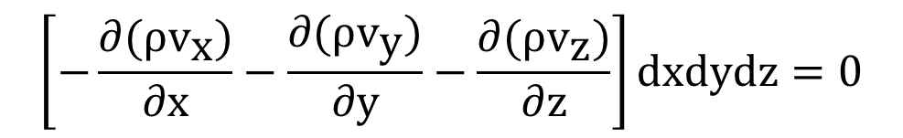
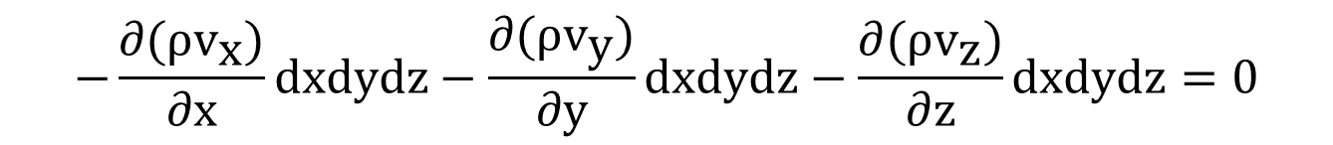
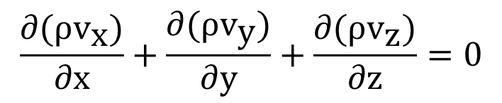
(inflow - outflow)_{total} = (inflow - outflow)_{x}
+ (inflow - outflow)_{y}
+ (inflow - outflow)_{z} = 0
$$−\frac{∂\text{(}ρ{\text{v}}_{\text{x}}\text{)}}{∂\text{x}}dxdydz−\frac{∂\text{(}ρ{\text{v}}_{\text{y}}\text{)}}{∂\text{y}}dxdydz−\frac{∂\text{(}ρ{\text{v}}_{\text{z}}\text{)}}{∂\text{z}}dxdydz=0$$
$$\left[−\frac{∂\text{(}ρ{\text{v}}_{\text{x}}\text{)}}{∂\text{x}}−\frac{∂\text{(}ρ{\text{v}}_{\text{y}}\text{)}}{∂\text{y}}−\frac{∂\text{(}ρ{\text{v}}_{\text{z}}\text{)}}{∂\text{z}}\right]dxdydz=0$$
$$\frac{∂\text{(}ρ{\text{v}}_{\text{x}}\text{)}}{∂\text{x}}+\frac{∂\text{(}ρ{\text{v}}_{\text{y}}\text{)}}{∂\text{y}}+\frac{∂\text{(}ρ{\text{v}}_{\text{z}}\text{)}}{∂\text{z}}=0$$

Slide 8
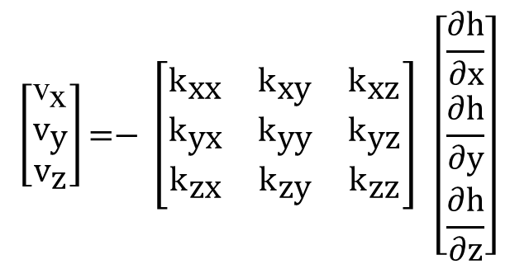
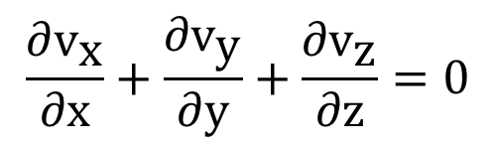
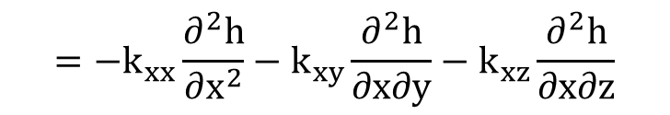
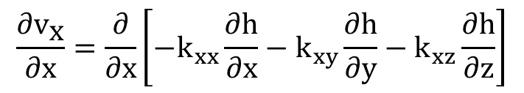
Assume that the fluid density is constant:
$$\frac{∂{\text{v}}_{\text{x}}}{∂\text{x}}+\frac{∂{\text{v}}_{\text{y}}}{∂\text{y}}+\frac{∂{\text{v}}_{\text{z}}}{∂\text{z}}=0$$
Use Darcy's law to express velocity:
$$\left[\begin{matrix}{\text{v}}_{\text{x}} \\ {\text{v}}_{\text{y}} \\ {\text{v}}_{\text{z}}\end{matrix}\right]\text{=− }\left[\begin{matrix}{\text{k}}_{\text{xx}} & {\text{k}}_{\text{xy}} & {\text{k}}_{\text{xz}} \\ {\text{k}}_{\text{yx}} & {\text{k}}_{\text{yy}} & {\text{k}}_{\text{yz}} \\ {\text{k}}_{\text{zx}} & {\text{k}}_{\text{zy}} & {\text{k}}_{\text{zz}}\end{matrix}\right] \left[\begin{matrix}\frac{∂\text{h}}{∂\text{x}} \\ \frac{∂\text{h}}{∂\text{y}} \\ \frac{∂\text{h}}{∂\text{z}}\end{matrix}\right]$$
$$\frac{∂{\text{v}}_{\text{x}}}{∂\text{x}}=\frac{∂}{∂x}\left[−k_{xx}\frac{∂h}{∂x}−k_{xy}\frac{∂h}{∂y}−k_{xz}\frac{∂h}{∂z}\right]$$
$$=−k_{xx}\frac{∂^{2}h}{∂x^{2}}−k_{xy}\frac{∂^{2}h}{∂x∂y}−k_{xz}\frac{∂^{2}h}{∂x∂z}$$

Slide 9
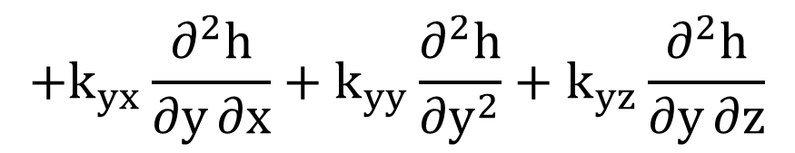
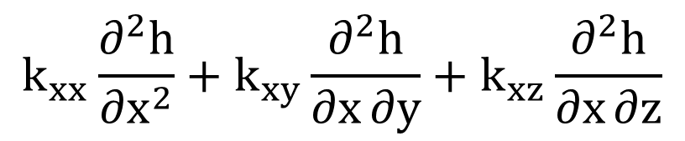
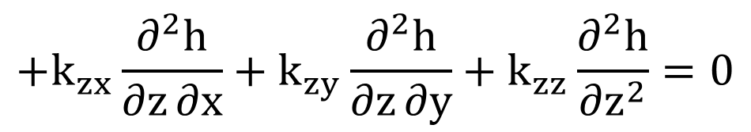
Substituting v_{x}, v_{y}, and v_{z}:
$$k_{xx}\frac{∂^{2}h}{∂x^{2}}+k_{xy}\frac{∂^{2}h}{∂x∂y}+k_{xz}\frac{∂^{2}h}{∂x∂z}$$
$$+k_{yx}\frac{∂^{2}h}{∂y∂x}+k_{yy}\frac{∂^{2}h}{∂y^{2}}+k_{yz}\frac{∂^{2}h}{∂y∂z}$$
$$+k_{zx}\frac{∂^{2}h}{∂z∂x}+k_{zy}\frac{∂^{2}h}{∂z∂y}+k_{zz}\frac{∂^{2}h}{∂z^{2}}=0$$

Slide 10
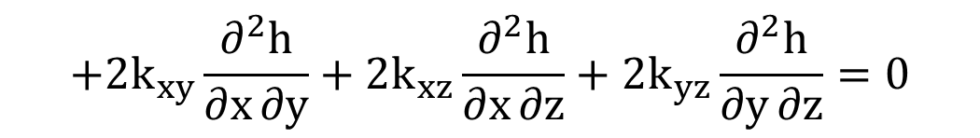
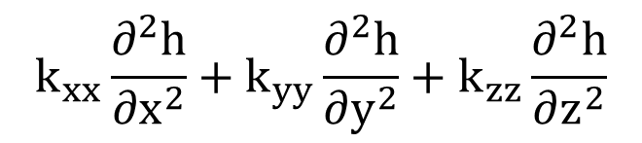
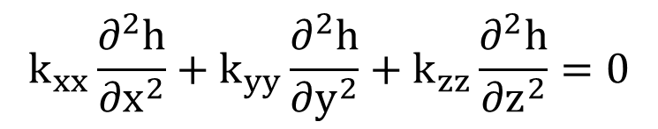

Combining terms:
$$k_{xx}\frac{∂^{2}h}{∂x^{2}}+k_{yy}\frac{∂^{2}h}{∂y^{2}}+k_{zz}\frac{∂^{2}h}{∂z^{2}}$$
$$+2k_{xy}\frac{∂^{2}h}{∂x∂y}+2k_{xz}\frac{∂^{2}h}{∂x∂z}+2k_{yz}\frac{∂^{2}h}{∂y∂z}=0$$
If x, y, and z correspond to principal axes of permeability:
$$k_{xy}=k_{xz}=k_{yz}=0$$
$$k_{xx}\frac{∂^{2}h}{∂x^{2}}+k_{yy}\frac{∂^{2}h}{∂y^{2}}+k_{zz}\frac{∂^{2}h}{∂z^{2}}=0$$

Slide 11
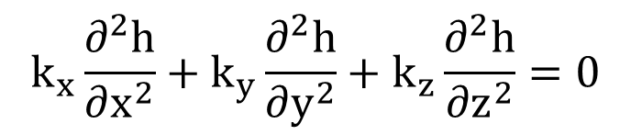
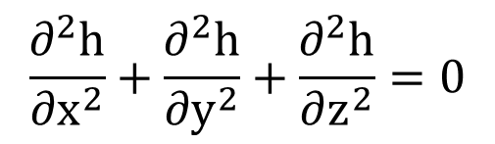
More commonly written as:
$$k_{x}\frac{∂^{2}h}{∂x^{2}}+k_{y}\frac{∂^{2}h}{∂y^{2}}+k_{z}\frac{∂^{2}h}{∂z^{2}}=0$$
if k_{x} = k_{y} = k_{z}:
$$\frac{∂^{2}h}{∂x^{2}}+\frac{∂^{2}h}{∂y^{2}}+\frac{∂^{2}h}{∂z^{2}}=0$$
"Laplace Equation"
The solution to any of these equations is a function describing h in terms of x, y, and z
h(x, y, z)

Slide 12
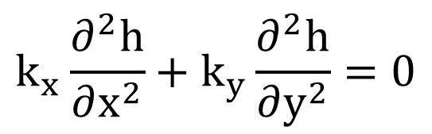
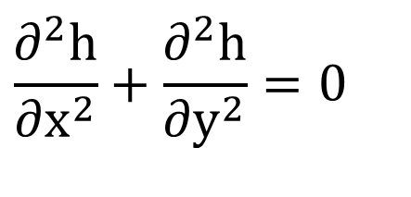
for the 2-D case:
$$k_{x}\frac{∂^{2}h}{∂x^{2}}+k_{y}\frac{∂^{2}h}{∂y^{2}}=0$$
if k_{x} = k_{y}:
$$\frac{∂^{2}h}{∂x^{2}}+\frac{∂^{2}h}{∂y^{2}}=0$$
and solution is of the form:
h(x, y)

Slide 13
Solving the Governing Equation

Slide 14
Solutions
In this course, we will examine three ways to solve the governing equation:
Graphical Solution (flow nets)

Slide 15
Solutions, cont.
Analytical solutions
Directly solve for an equation

Slide 16
Solutions, cont.
Numerical solutions
Finite Difference
Finite Element

Slide 17
Boundary Conditions
Regardless of the solution technique, before we can solve the differential equation for h(x, y, z), we must define some boundary conditions.
Sample boundary conditions:

Slide 18
Sample BC, cont.

Slide 19
Sample BC, cont.

